Slide 1
Girmit Museum Project
An Initiative by Global Girmit Institute – Fiji Islands
@ The International Conference – Forced Labour &Migration – University of Fiji – 15-17 July 2019
Presenter- Vijendra Prasad

Slide 2
GMP Framework & Features
Stage 1: Artefact Museum
Collection of Girmit era artrfacts to show case the lifestyle then, these can include objects that made up their Home, Farms, Lifestyle , Music , Dance , Garment, Jewellery and community and or religious events. You may wish to suggest few more options.
Exhibiting the relationship between the Fiji Sugar Industry & Girmit, Showcasing – Collection of Equipment, Machinery, Farm Implements, Farm Life
Active Programmes including interactive facilities for school children and Educational seminars, in forms of storytelling, reading from History Books and participating in the choreographed shows.
Education and support from the Professor Brij Lal Library housing assorted books on Diaspora and History of Fiji to enable researchers and students study and research their own past.
Café with menu including foods from the South Pacific
Tracing developments from Girmit to Present and celebrating the achievements of Girmitya contribution.
Stage 2: Virtual Museum
Taking Girmit Museum into the homes and fingertips of Global World via Virtual and Internet technology.
Preserving for posterity the Past for the benefit of the Future Generation.
Stage 3: Live Museum
Eventual development of a live museum.

Slide 3
The Project Background
Some 60,500 plus labourers from India were sent to Fiji Islands by the British Government between 1879 and 1916, Majority of Fiji residents now can make a claim to be direct descendants of these Girmityas. One can research numerous writers both academic and story tellers through the internet access.
No dedicated History Museum exists in Fiji to immortalise the History of Girmit although Fiji Museum has had exhibits showcasing a range of lifestyle artefacts whilst the Fiji Girmit Council has offered a number of Programmes under its Multicultural banner.
The Global Girmit Institute [GGI] has decided that a Dedicated History Museum to focus on Girmityas be established, believing that a non-profit making permanent institution in service of society and of its development and open to all Fiji Residents and those residing abroad is long overdue.
History Museums provide a place for entertainment as well as for people to engage with their Past and further their education across all age groups.

Slide 4
Mission & Vision
Mission
To collect, preserve and use in a sustainable manner the Girmityas tangible and intangible heritage for the purpose of: increasing knowledge and understanding of; developing interest and pride in; and promoting appreciation and respect for the heritage throughout Fiji Islands and World Stage.
Vision
To be a centre of excellence in the quest for and dissemination of knowledge on the collective memory and in the preservation of the National Heritage of the people of the Fiji Islands and to be a source of inspiration for posterity for current and future generations.

Slide 5
Scope
Terms of Reference: [Objectives]
Commence preparatory work for the GMP
Propose designs for the GM
Locate land for the Museum and report to the committee for further deliberations
Locate and source funds for the Project
Build a dynamic GMP Taskforce
Build GM collection

Slide 6
SWOT Analysis
SWOT Analysis
Strengths | Opportunities
Consideration of the Need for the History Museum and the Girmit Legacy Passion of the People in Community Potential for the Visitor and Resident Partnership International recognition | Population [Residents and Visitors] Lack of alternatives Heritage preserved and promoted Fijian Culture & partnership with Fiji Gov. Foreign & Ex-Fiji residents’ support A Shrine for Girmityas
Weaknesses | Threats
Insufficient Budget / Fundraising hurdles Dampened Community Involvement Workers & Volunteers not adequately Collection Development Patronizing Identities | Personal agendas; threat felt by those who feel Girmit is their turf. Departure of focus on Girmit Local & National Politics; Government intervention Cash Flow Management

Slide 7
Project Action Plan
Acquisition of Land - Search Locate and acquire suitable parcel of land. [This is work in progress]
Design and Sketch of the Building-Identify Person who is able to design and provide sketch concept [This is work in progress]
Land Scaping and Layout of Museum Grounds- Identify and secure Land Scaping Professionals
Governance & Funding - Capacity of attract one–off and ongoing donations [WIP]
Collaboration with Government, NGOs & Community based Organisations, Fiji Museum, Tui Vuda, Ministry of Arts & Culture – Republic of Mauritius
Creating Archival Material Depository for Dedicated Research

Slide 8
Resources
Establish Support Network -Write letters of invitation to identified persons with potential to help provide support for Project-
Publicity & Communication- Plan and Execute a Campaign to promote GMP, Radio, TV, News Paper, Schools, Network
Identify a Champion of National or International Reputation - Patron
Collection / Exhibition/ Displays of Girmit Era Artefacts
Exchanging or Borrowing of Artifacts from Museums located in Girmit Countries
Education Programme & Community Participation
Creating facilities to host scholars working on Indenture labourers and their Descendants

Slide 9
Stage 2 – A Virtual Museum
Use Technology to record and reach out to people in their homes or locations of their choice the artefacts’ and Girmit History.
Stage 3 – A Live Museum
On a 10-15 acre plot, development of a live museum, creating maximum experience environment.

Slide 10
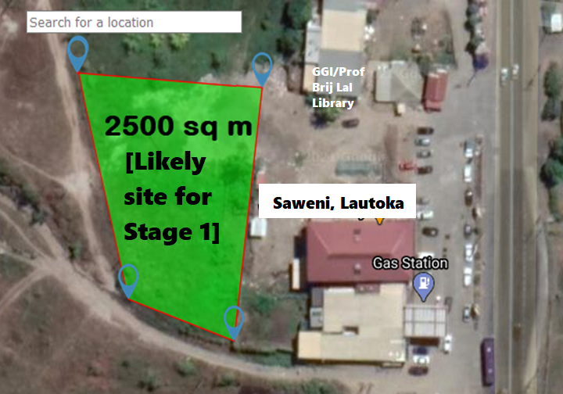
Likely Site: Stage 1

Slide 11
Appreciation
Thank You
Dhanyavaad
Vinaka Vaka levu
Ni sa Moce

